Slide 1
Sonoma Pharmaceuticals, Inc. Investor Presentation April 2025

Slide 2
Legal Disclaimers
INVESTOR PRESENTATION
This communication is for informational purposes only. The information contained herein does not purport to be all-inclusive. The data contained herein is derived from various internal and external sources. No representation is made as to the reasonableness of the assumptions made within or the accuracy or completeness of any information contained herein. Any data on past performance is no indication as to future performance. Sonoma Pharmaceuticals, Inc. and its subsidiaries (“Sonoma” or, the “Company”) assumes no obligation to update the information in this communication. This presentation is not an offer to buy or the solicitation of an offer to sell Sonoma securities.
FORWARD-LOOKING STATEMENTS
Except for historical information herein, matters set forth in this presentation are forward-looking within the meaning of the “safe harbor” provisions of the Private Securities Litigation Reform Act of 1995, including statements about the commercial and technology progress and future financial performance of Sonoma Pharmaceuticals, Inc. and its subsidiaries.
These forward-looking statements are identified by the use of words such as “believe,” “achieve,” and “expect,” among others. Forward-looking statements in this presentation are subject to certain risks and uncertainties inherent in the Company’s business that could cause actual results to vary, including such risks that regulatory clinical and guideline developments may change, scientific data may not be sufficient to meet regulatory standards or receipt of required regulatory clearances or approvals, clinical results may not be replicated in actual patient settings, the Company will not have sufficient capital to implement its business plan, invalidated or circumvented by its competitors, the available market for the Company’s products will not be as large as expected, the Company’s products will not be able to penetrate one or more targeted markets, revenues will not be sufficient to fund further development and clinical studies, uncertainties relative to fluctuations in foreign currency exchange rates, global economic conditions, prospective tariffs or changes to trade policies, as well as uncertainties relative to varying product formulations and a multitude of diverse regulatory and marketing requirements in different countries and municipalities, and other risks detailed from time to time in the Company’s filings with the Securities and Exchange Commission. The Company disclaims any obligation to update these forward-looking statements, except as required by law.
TRADEMARKS AND INTELLECTUAL PROPERTY
All trademarks, service marks, and trade names of the Company and its subsidiaries or affiliates used herein are trademarks, service marks, or registered trademarks of the Company as noted herein. Any other product, company names, or logos mentioned herein are the trademarks and/or intellectual property of their respective owners.
2

Slide 3
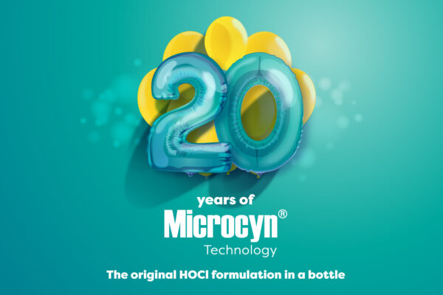
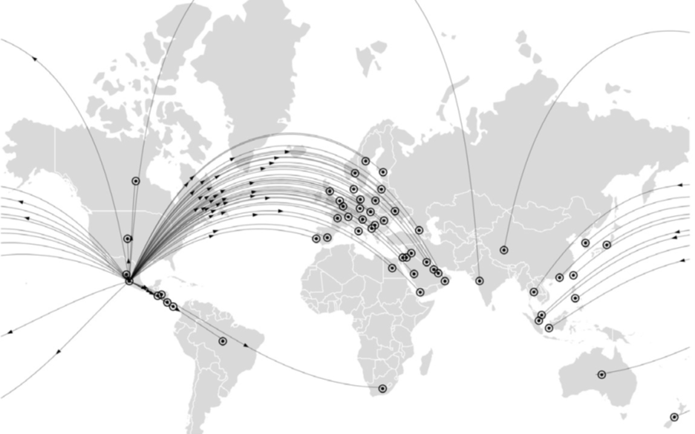
About Sonoma
Sonoma Pharmaceuticals is a global healthcare leader for developing and producing stabilized hypochlorous acid (HOCl) products for a wide range of applications, including wound, eye, oral and nasal care, dermatological conditions, podiatry, animal health care and non-toxic disinfectants. Sonoma’s products are clinically proven to reduce itch, pain, scarring, and irritation safely and without damaging healthy tissue. In-vitro and clinical studies of HOCl show it to safely manage skin abrasions, lacerations, minor irritations, cuts, and intact skin.
Sonoma’s products are sold either directly or via partners in 55 countries worldwide. Sonoma actively seeks new distribution partners.
3
Notes:
3

Slide 4
Investment Highlights
Hypochlorous Acid Industry Leader
Over 20 years of experience developing and manufacturing products containing HOCl, over 100 research articles, papers and clinical and case studies, over 50 active U.S. and international patents, and continual product innovation
22 U.S. FDA clearances as 510(k) medical devices, transition to MDR completed for all revenue-producing products, and extensive worldwide regulatory clearances
Utilized on millions of patients worldwide without a single report of serious adverse effect
Diverse Global Healthcare Business
Focused on billion-dollar markets in Rx and OTC dermatology, wound care, eye, oral and nasal care, podiatry, animal health and non-toxic disinfectants, treating common injuries and managing irritations
Robust and diverse international partner network selling into over 55 countries and extensive worldwide regulatory clearances means products can be commercialized faster
FDA registered medical device manufacturing capabilities in Mexico lowers COGS and creates opportunities for volume plays
4
Notes:
4

Slide 5
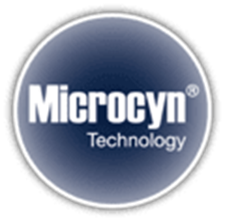
Sonoma’s Microcyn® Technology
Patented, Stabilized Triple-Action Topical Technology
HOCl kills microbes including bacteria, fungi and viruses while assisting healing
Relieves pain and itch
Improves wound care by cleaning and moistening the wound and peri-wound area
Safely manage skin abrasions, lacerations, minor irritations, cuts, burns, and intact skin
Applications in dermatology include atopic dermatitis, scar treatment and daily care
May replace other treatments with side effects or health concerns
Overused antibiotics may cause deadly epidemics such as MRSA
May replace steroids for some patients
Avoids harmful ingredients such as benzoyl peroxide
Cost Effective
Reduces hospital/physician visits
Medicare/hospital savings from reduced hospital stays
5
Notes:
5

Slide 6
Sonoma’s Microcyn® Technology
Unparalleled Safety
No drug-to-drug interaction or contraindications
Millions of patients treated worldwide without a single report of serious adverse effect
30+ human clinical trials with over 1,500 patients
Products contain all-natural hypochlorous acid
Industry Leader
Strong U.S. and international regulatory portfolio
Longer shelf life than most competitors while retaining efficacy
Available in solution, hydrogels and in combination with silicone for scar treatment
White label available with custom packaging and design
Established Microcyn® brand
State of the art manufacturing
6
Notes:
6

Slide 7
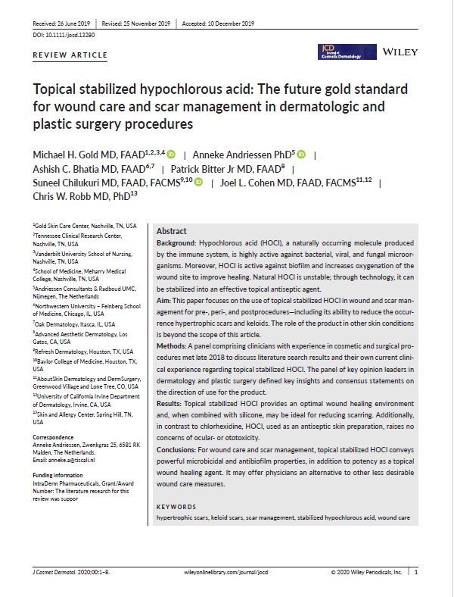
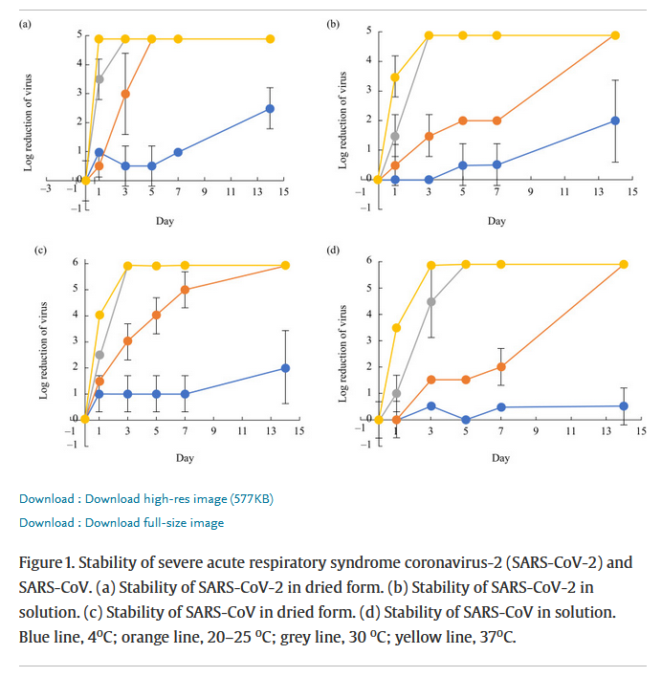
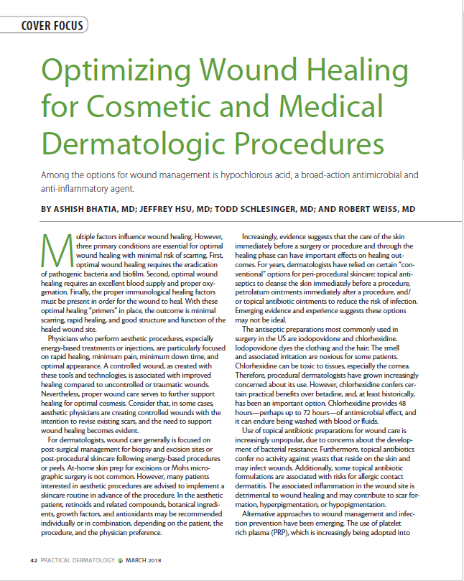
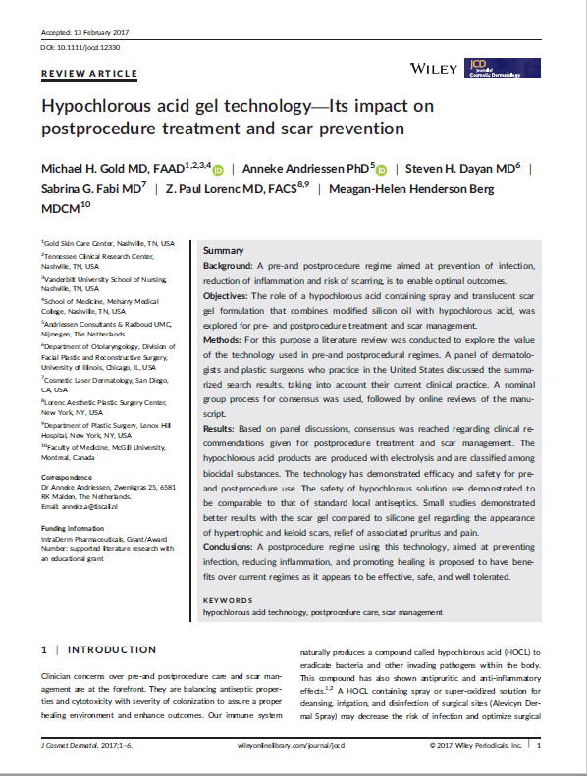
Over 100 research articles and case and clinical studies showcasing both the efficacy and safety of our Microcyn® technology
Dermodacyn® Disinfecting solution study on viability of SARS-CoV-2, see https://www.sciencedirect.com/science/article/pii/S019567012030339X
Endocyn® study on cellular toxicity, see https://www.sciencedirect.com/science/article/abs/pii/S0099239917310439
HOCl study evaluating virucidal activity in Vero E6 cells against SARS-CoV-2, University of Barcelona, 11/27/2020
Hypochlorous acid gel technology—Its impact on post-procedure treatment and scar prevention, see https://sonomapharma.com/wp-content/uploads/2020/08/Gold_et_al-2017-Journal_of_Cosmetic_Dermatology-003.pdf
Topical stabilized hypochlorous acid: The future gold standard for wound care and scar management in dermatologic and plastic surgery procedures, see https://sonomapharma.com/wp-content/uploads/2020/08/Topical-Stabilized-HOCL-consensus-article-2020.pdf
HOCl Article: Optimizing Wound Healing for Procedures – Apr 2018, see https://sonomapharma.com/wp-content/uploads/2018/11/Pracitcal-Derm-HOCl-article-4-7-18-wounds.pdf
7

Slide 8
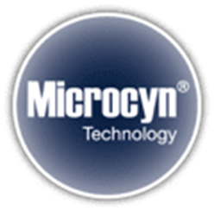
Wide Range of Applications
Wound Care
Dermatology
Eye Care
Oral and Dental Care
Animal Health Care
Surface Disinfectants
Podiatry
Senior Care
8

Slide 9
Our Wound Care Business is Growing in the U.S. and Internationally
Celebrating 20 years of selling wound care
In August 2024, we added Medline Industries, LP as a U.S. distributor for our wound care
products – Medline is one of the largest medical supply distributors in the United States
In October 2024, we expanded our partnership with Medline to include distribution
in Canada, and OTC wound care sales to retailers in both countries
We sell wound care across Europe and added a new distributor for wound care in Ukraine in 2024
Expanding Product Lines: including new options for our Microcyn® Negative Pressure Wound Therapy Solution product line.
Product innovation: In June 2023, we announced a new
application of our Microcyn® technology for intraoperative
pulse lavage irrigation treatment.
9

Slide 10
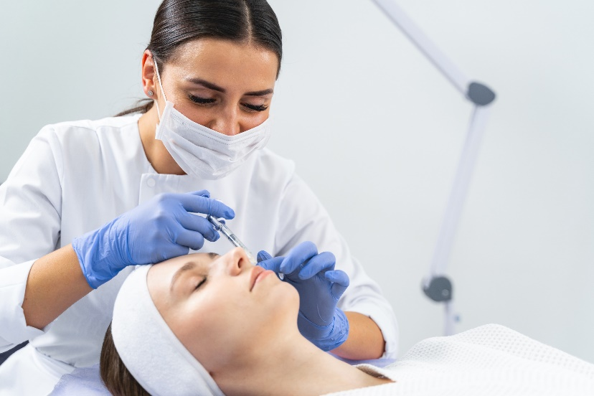
Industry-Leading Safe and Effective Dermatology Products
Products to relieve symptoms of atopic dermatitis, reduce scarring, and for daily skin care
Line of office dispense products targeting growing med spa market
Eczema seal of approval
All natural ingredients
No harmful chemicals
OTC, office dispense, and Rx products available
Innovating packaging available including high end and cost competitive options
Continual Product Innovation: Introduced LumacynTM Clarifying Mist in 2024, a daily toner formulated to reduce redness and manage blemishes by reducing infections.
10

Slide 11
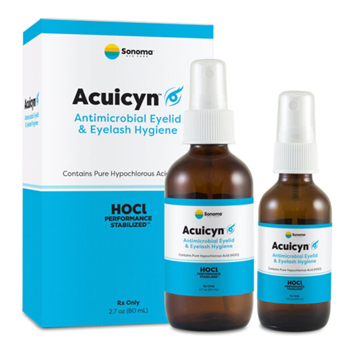
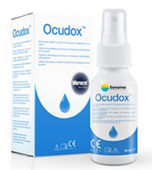
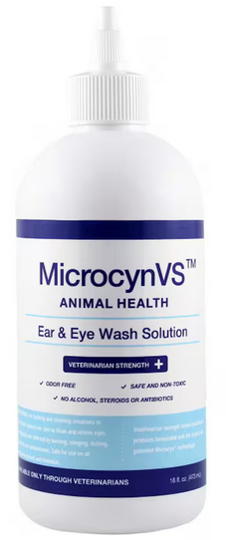
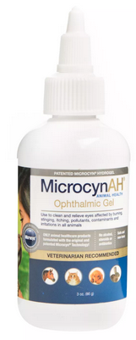
Expanded Eye Care Product Line
Sonoma has the strongest FDA indications for eye care in the HOCl industry
OTC and prescription eye care sold into multiples channels
Strong CE Mark for eye care sales in the EU
Animal health eye care sold in major chains including PetSmart and Tractor Supply
11

Slide 12
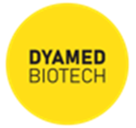
Robust U.S. and International Distribution Network
over 40 global partners and growing
We continue to:
Expand our presence in new markets by replicating what works in existing markets
Add new distribution partners and grow existing relationships
Co-develop innovative new products with partners
Work with partners to seek new approvals and certifications
12
Notes:
12

Slide 13
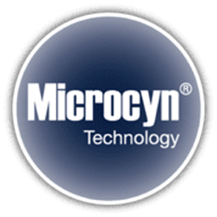
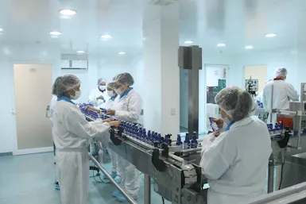
Cutting Edge Manufacturing
57,153 square foot state-of-the-art facility
ISO 9001, ISO 13485 and cGMP certified
MOH, KFDA, SFDA, KSA, TGA, EN, Biocide and numerous other national listings and approvals
Shipping to over 55 countries, with multiple methods for shipments
Highly trained staff of 162 employees
Additional 11,840 square feet of overflow capacity
Currently operating at 40% capacity
with margin of approximately 35%
Flexible operations capable of custom labeling, SIZING, packaging & dispense modes
High or small volume, large or small batch, delivered in 12 weeks
13

Slide 14
14

Slide 15
Growth Strategy
Manufacturing capabilities can support significant future growth, leading to improved margins overall
Continue to introduce new high
margin products
Efficient, flexible and FDA-regulated manufacturing facility currently operating at only 30% capacity
Seek new manufacturing customers to utilize overflow space
Launch new applications of Sonoma’s Microcyn® technology for consumer-focused products, including in the dermatology and aesthetic space
Invest in R&D to expand commercialization opportunities
Expand Rx and OTC reach in U.S.
Seek additional regulatory clearances for expanded indications
Introduce new technology to new markets
Fully commercialize robust pipeline of new products via direct-to-consumer sales or distribution partnerships
Increase sales of dermatology products through the direct dispense model that generates Sonoma’s highest margins
Increase direct-to-consumer marketing in niche markets
Seek retail partners for OTC products
Expand eye care marketing for Rx and OTC
15
Notes:
15

Slide 16
New Market Opportunities
Sonoma is expanding its partnerships and product offerings in the eye care, all-natural skin care, medical spa and animal health care industries.
The global eye care market size was estimated at USD $70.78 billion in 2023 and is projected to grow at a compound annual growth rate (CAGR) of 6.72% from 2024 to 2030.¹
The global natural skin care products market size was valued at $6.7 billion in 2021 and is expected to expand at a CAGR of 6.6% from 2022 to 2030.²
The global medical spa market size was estimated at USD 18.6 billion in 2023 and is expected to grow at a CAGR of 15.13% from 2024 to 2030.³
North America dominated the medical spa market with a share of 41.1% in 2023, due to higher expenditure on wellness tourism than other regions.⁴
The global animal health market size was valued at USD 62.40 billion in 2023 and is projected to grow at a CAGR of 9.0% from 2024 to 2030.⁵
16
Notes:
16

Slide 17
Recent Business Developments
Introduction of new products using our Microcyn® technology
In December 2024, we announced the relaunch of our prescription eye care product, Acuicyn®, our prescription dermatology products Celacyn®, Levicyn® and Epicyn®, and our over-the-counter Lasercyn® Dermal Spray and Lasercyn Gel.
In September 2024, we announced the consumer-friendly redesign of Ocucyn® Eyelid & Eyelash Cleanser.
In April 2024, we announced expansion of our Microcyn® Negative Pressure Wound Therapy Solution product line, now available in 250mL, 450mL and 990mL sizes to meet the diverse needs of healthcare professionals and patients.
In January 2024, we launched LumacynTM Clarifying Mist, a new direct-to-consumer skincare product in the United States. Lumacyn is an all-natural daily toner formulated with Microcyn technology to soothe the skin and relieve irritation.
In June 2023, we announced a new application of our Microcyn technology for intraoperative pulse lavage irrigation treatment, which can replace commonly used IV bags in a variety of surgical procedures.
Our MicrocynAH® products are now available through Pets at Home, with over 450 stores across the UK, through our partner Compana Pet Brands
In May 2024, we announced expansion of our MicrocynAH animal health care products in the Menards® chain of home improvement stores in the United States, through Compana Pet Brands.
In April 2023, we launched PodiacynTM Advanced Everyday Foot Care direct to consumers for over-the-counter use in the United States.
17
Notes:
17

Slide 18
Recent Business Developments
Expanding commercialization opportunities by investing in R&D
We successfully transitioned all of our commercialized products in Europe, including eye care, wound care, scar gel, acne products and atopic dermatitis products to the new European Union (EU) Medical Device Regulation (MDR).
Our manufacturing facility and five of our products are successfully registered with the Medicines & Healthcare products Regulatory Agency (MHRA) in the United Kingdom, including our wound irrigation solution and hydrogel, scar management products and acne products.
In 2024 we received two new 510(k) clearances from the FDA, including specific over-the-counter indications for the face, eyelid and eyelashes, as well as improved biocompatibility for our Microcyn-based solution and hydrogel.
In March 2023, we announced new EPA claims for Nanocyn® Hospital-Grade Disinfectant for effective use against MRSA, Salmonella, Norovirus, Poliovirus, and as a fungicide. Nanocyn was previously approved for use against COVID-19 and emerging pathogens including Ebola virus, Mpox, and SARS-CoV-2. Nanocyn also received the esteemed Green Seal® Certification. In August 2024, the Australian TGA approved new claims for use against C. auris and C. diff.
Reliefacyn® Advanced Itch-Burn-Rash-Pain Relief Hydrogel was awarded the National Eczema Association Seal of AcceptanceTM
A recent publication in the journal Neurourology and Urodynamics highlighted the potential for Microdox® in the management of urinary tract infections, or UTIs, in children with neurogenic or non‐neurogenic bladder dysfunction.¹
1. Singh G‐K, Deshpande A, Schlegel G, Starkey M, Taghavi K. The rationale for bladder washouts in children with neurogenic bladder. Neurourol Urodyn. 2024;1‐6. doi:10.1002/nau.25450
18
Notes:
18

Slide 19
Recent Business Developments
Continuously expanding our distributor network
In April 2025, we announced the launch our of acne products in the U.K. through a leading health and beauty retailer and pharmacy chain.
In January 2025, we partnered with WellSpring Pharmaceutical Corporation for the sale of our Microcyn technology-based products to large retailers in the United States.
In March 2025, we expanded our agreement with WellSpring to include additional consumer focused products.
In August 2024, we announced a new distribution agreement with Medline Industries, LP for the marketing and distribution of our wound care products in the United States.
In October 2024, we expanded our agreement with Medline for marketing and distribution of our wound care products in Canada, and the sale of OTC wound care products to retailers in both countries.
In July 2024, we announced a new distribution agreement for wound care in Ukraine.
In April 2023, our partner Te Arai BioFarma Limited launched BabySoothe for diaper rash applications in Taiwan.
In April 2024, Te Arai launched Microdacyn for wound care in Taiwan.
Our partner Microderm Technologies recently launched Dermodacyn for wound care applications in Thailand.
Our partner Brill Pharma SL is now selling Sonoma’s eye care products in Italy, Spain, Portugal and Germany.
In January 2023, we entered into a distribution agreement with Daewoong Pharmaceutical Co., Ltd., one of the largest pharmaceutical companies in South Korea, for marketing and distribution of PrimocynTM Skin Solution products
19
Notes:
19

Slide 20
Management
Amy Trombly
CEO
Amy Trombly is our Chief Executive Officer and also serves on our Board of Directors. She counseled public companies for over two decades in corporate and securities law and mergers and acquisitions, including as the owner and manager of Trombly Business Law, PC. In her earlier career, Ms. Trombly was a Vice President at State Street Bank and Special Counsel at the U.S. Securities and Exchange Commission. Ms. Trombly is a member of the bar in Massachusetts and Colorado.
Bruce Thornton
COO
Bruce Thornton has served as our Chief Operating Officer, Vice President of Global Operations, and US General Manager since 2004, and currently as Executive Vice President and Chief Operating Officer. He served as Vice President of Operations for Jomed (formerly EndoSonic Corp.) from January 1999 to September 2003, and as Vice President of Manufacturing for Volcano Therapeutics, an international medical device company, following its acquisition of Jomed, until March 2004. Mr. Thornton received a B.S. in Aeronautical Science from Embry-Riddle Aeronautical University and an M.B.A. from National University. He also has served in the US Army.
Jerry Dvonch
CFO
Mr. Dvonch serves as our Chief Financial Officer. He joined us from the SpineCenter Atlanta where he was the controller and Senior Vice President of Finance and Accounting since March 2017. From March 2016 to April 2016 he was a consultant controller for DS Healthcare Group, Inc. Prior to that he was the director for external reporting and director of finance of NeoGenomics Laboratories from July 2005 to July 2015. He has over 10 years of experience with SEC reporting. Mr. Dvonch is a licensed Certified Public Accountant in New York. He holds a Master of Business Administration in Finance from the University of Rochester and a Bachelor of Business Administration in Accounting from Niagara University.
20

Slide 21
Key Financial Metrics
Nine months ended December 31, 2024 -
Revenues increased 13% compared to same period FY 2024
Net loss improved $1.1 million, or 29%, compared to same period FY 2024
Three months ended December 31, 2024 -
Revenues increased 14% compared to same period in FY 2024
Positive cash flow from operations for the quarter with $5.2 million of cash at December 31, 2024
21

Slide 22
APPENDIX: Product Portfolio

Slide 23
23

Slide 24
24

Slide 25
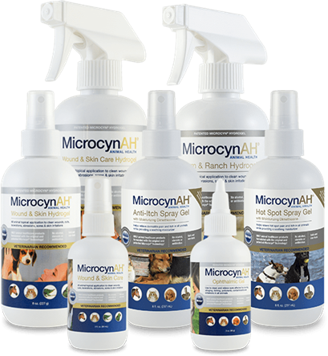
U.S. Animal Health Care
MicrocynAH® family of advanced animal healthcare products, safe to use on pets and livestock, and perfect for hot spots, pink eye, scratches, skin rashes and ulcers, cuts, burns, post-surgical sites, irritated skin and lacerations.
Sold in national pet-store retail chains and specialty stores such as PetSmart, Chewy, Tractor Supply, Cabela’s, Bass Pro Shops and Menards.
MicrocynVS® veterinarian-strength animal care for use in vet clinics and animal hospitals.
25

Slide 26
26

Slide 27
27

Slide 28
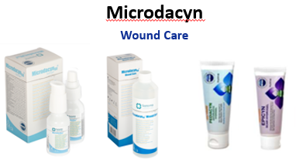
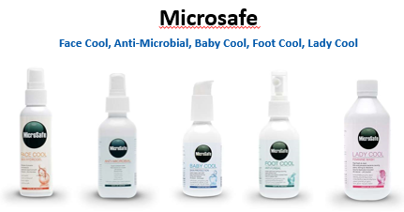
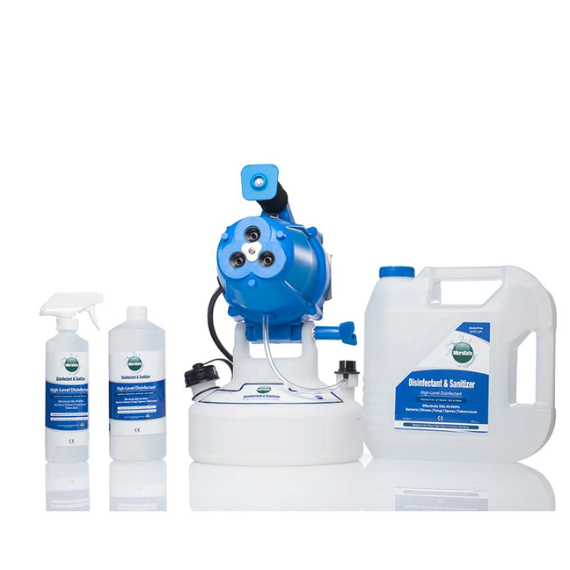
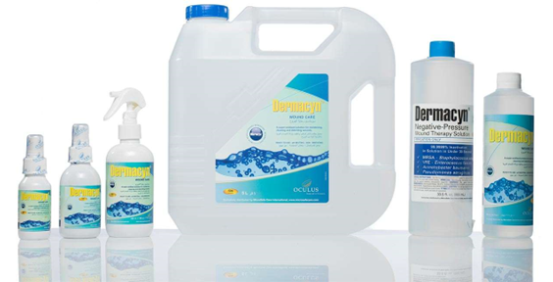
Middle East
28

Slide 29
Asia
Singapore, Malaysia, Thailand, Indonesia
Wound Care
China
Microcyn
Hong Kong
Microdacyn60 Oral Care
South Korea
BioDerm Biodacyn60 Wound Care
The Philippines
Microdacyn
MicrocynAH®
29

Slide 30
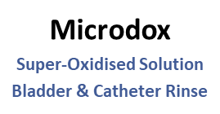
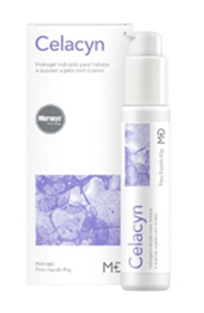
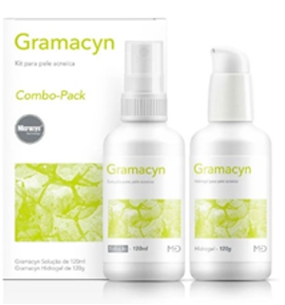
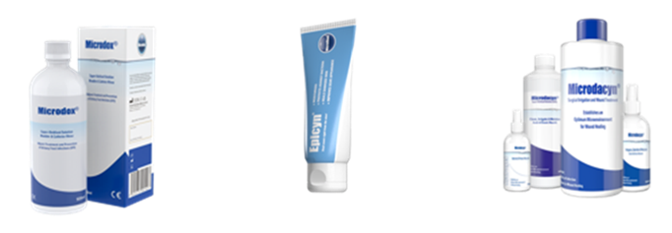
Latin America
Australia & New Zealand
Gramacyn
^{Kit for Acne Skin}
Epicyn
Treat Scars Right from the Start
30

Slide 31
THANK YOU
Sonoma Pharmaceuticals Inc. 5445 Conestoga Court, Suite 150 Boulder, CO 80301 United States of America Phone: 1-(800) 759.9305 Email: busdev@sonomapharma.com Website: www.sonomapharma.com
NASDAQ: SNOA

