Slide 1
BUILDING THE FUTURE
Rendering of the Cavorite X7 in flight
NASDAQ: HOVR
©2025 NEW HORIZON AIRCRAFT LTD. | PRIVATE AND CONFIDENTIAL

Slide 2
Cautionary note about forward-looking statements
This document contains forward-looking statements regarding, among other things, the strategies of Robinson Aircraft Ltd. (“Horizon Aircraft” or “we” or “our”) which may constitute “forward-looking statements” within the meaning of the United States Securities Act of 1933, as amended (the “U.S. Securities Act”) and the United States Securities Exchange Act of 1934, as amended by the Private Securities Litigation Reform Act of 1995, including but not limited to the ability of Horizon Aircraft to successfully complete testing and certification of its Cavorite X7 eVTOL quickly and then to enter the market and service a broad spectrum of early use cases, including the targeted future production of Horizon’s Cavorite X7 aircraft; the ability of the Cavorite X7 to take off and land like a helicopter and fly twice as fast; the projected useful load, estimated maximum speed and projected range of the Cavorite X7 aircraft; the ability of the Cavorite X7 to fly 98% of its mission in a like a traditional aircraft; the certification for flight into known icing; and the ability of the Cavorite X7 to be fast, versatile, and built for bad weather. Generally, statements that are not historical facts, including statements concerning possible or assumed future actions, business strategies, events or results of operations, are forward-looking statements. The forward-looking statements represent our current expectations, estimates, forecasts and assumptions, and are based on information available as of the date hereof and involve known and unknown risks, uncertainties, assumptions and other factors which may cause our actual results, performances or achievements to be materially different from any future results, performances or achievements expressed or implied by the forward-looking statements. Such risks and uncertainties include, but are not limited to: the size and growth of the regional air mobility market generally; our ability to develop, certify and produce aircraft that meet our performance expectations, the competitive environment in which we plan to operate; our present and future capital needs to achieve our goals; our ability to adequately protect and enforce our intellectual property rights; our ability to effectively respond to evolving regulations and standards relating to our planned aircraft; and uncertainties related to our limited operating history and that we face significant challenges to develop, certify, and manufacture its aircraft. Although Horizon Aircraft believes that its plans, intentions and expectations reflected in or suggested by these forward-looking statements are reasonable, Horizon Aircraft cannot assure you that Horizon Aircraft will achieve or realize these plans, intentions or expectations. Forward-looking statements are not guarantees of performance. As such, you should not place undue reliance on these forward-looking statements and you should read this document completely and with the understanding that our actual future results may be materially different from what we expect. All forward-looking statements are qualified in their entirety by this cautionary statement. Horizon Aircraft undertakes no obligation to update or revise forward-looking statements to reflect changed assumptions, the occurrence of unanticipated events or changes to future operating results or circumstances, whether as a result of new information, future events or otherwise, except as may be required under applicable securities laws. No securities regulatory authority has expressed an opinion about Horizon Aircraft securities and it is an offense to claim otherwise.
©2025 NEW HORIZON AIRCRAFT LTD.
PRIVATE AND CONFIDENTIAL
2

Slide 3
Projections and future-oriented financial information
This document contains certain projections or future oriented financial information about prospective results of operations, financial position or cash flows, based on assumptions about future economic conditions and courses of action and that is not presented in the format of a historical balance sheet, income statement or cash flow statement. The projections or FOFI have been prepared by Horizon Aircraft’s management to provide an outlook of Horizon Aircraft’s activities, results and anticipated use of proceeds. The projections or FOFI have been prepared based on a number of assumptions, including assumptions with respect to the costs and expenditures to be incurred by Horizon Aircraft, capital expenditures and operating costs, taxation rates for Horizon Aircraft and general and administrative expenses. Management does not have firm commitments for all of the costs, expenditures, prices or other financial assumptions used to prepare the projections or FOFI or assurance that such operating results will be achieved and, accordingly, the complete financial effects of all of those costs, expenditures, prices and operating results are not objectively determinable. The actual results of operations of Horizon Aircraft and the resulting financial results will likely vary from the amounts set forth in the analysis presented in this document, and such variation may be material. Horizon Aircraft and its management believe that the projections or FOFI have been prepared on a reasonable basis, reflecting management’s best estimates and judgments. However, because this information is highly subjective and subject to numerous risks including the risks discussed above, it should not be relied on as necessarily indicative of future results. Except as otherwise required by applicable securities laws, Horizon Aircraft undertakes no obligation to update such projections or FOFI and forward-looking statements and information.
Disclaimer
This document is for informational purposes only and is being made available solely to enable prospective “accredited” and other qualified investors authorized by Horizon Aircraft to evaluate an investment in the securities of Horizon Aircraft (the “Securities”). This document does not constitute an offer to sell or the solicitation of an offer to buy the Securities, nor shall there be any sale of Securities, in the United States, Canada, any state, any province or any other jurisdiction in which such offer, solicitation or sale would be unlawful prior to registration or qualification under the securities laws of such jurisdiction. The Securities have not been and will not be registered under the U.S. Securities Act or any state securities laws and may not be offered or sold in the United States, or to or for the account or benefit of a U.S. Person (as defined in Regulation S under the U.S. Securities Act), except in compliance with the registration requirements of the U.S. Securities Act and applicable state securities laws or pursuant to an exemption therefrom.
No warranties
The information contained in this document does not purport to be all-inclusive and neither Horizon Aircraft nor any other person makes any representation or warranty, express or implied, as to the completeness, accuracy or reliability of the information contained in this document. In particular, the general explanations included in this document cannot address, and are not intended to address, each prospective purchaser’s specific investment objectives, financial situations or financial needs. Accordingly, by accepting this document, each prospective purchaser confirms that such purchaser is not relying upon the information contained in this document to make any investment decision. Prospective purchasers should consult with their own counsel and tax and financial advisors as to legal and related matters concerning the matters described in this document.
Third party information
Certain information contained herein includes market and industry data that has been obtained from or is based upon estimates derived from third party sources, including industry publications, reports and websites. Third party sources generally state that the information contained therein has been obtained from sources believed to be reliable, but there is no assurance or guarantee as to the accuracy or completeness of included data. Although the data is believed to be reliable, Horizon Aircraft has not independently verified the accuracy, currency or completeness of any of the information from third party sources referred to in this document or ascertained from the underlying economic assumptions relied upon by such sources. Horizon Aircraft hereby disclaims any responsibility or liability whatsoever in respect of any third-party sources of market and industry data or information.
©2025 NEW HORIZON AIRCRAFT LTD.
PRIVATE AND CONFIDENTIAL
3

Slide 4
Founded in 2013
A group of pilots and operators
An elite team that has designed, built and flown new aircraft
Extensive list of patents, trade secrets, and other unique technology
©2025 NEW HORIZON AIRCRAFT LTD.
PRIVATE AND CONFIDENTIAL
4

Slide 5
LEADERSHIP
Our team of industry trailblazers includes visionary entrepreneurs with high-growth startup expertise and aerospace engineers with military-proven leadership.
BRANDON ROBINSON
CHIEF EXECUTIVE, FOUNDER
CF-18 Fighter Pilot and Top Gun graduate
Mechanical Engineer and MBA
Major project directorship exceeding $400 million budget
JASON O’NEILL
CHIEF OPERATING OFFICER
20 years of high-growth start-up
Machine learning, software architecture and integration
BRIAN ROBINSON
CHIEF ENGINEER, FOUNDER
Experimental aircraft builder and pilot
Mechanical Engineer, P.Eng
50 years of custom aviation engineering
BRIAN MERKER
CHIEF FINANCIAL OFFICER
More than 20 years in financial management; more than 10 years in aviation
Former KPMG; extensive public company experience
©2025 NEW HORIZON AIRCRAFT LTD.
PRIVATE AND CONFIDENTIAL
5

Slide 6
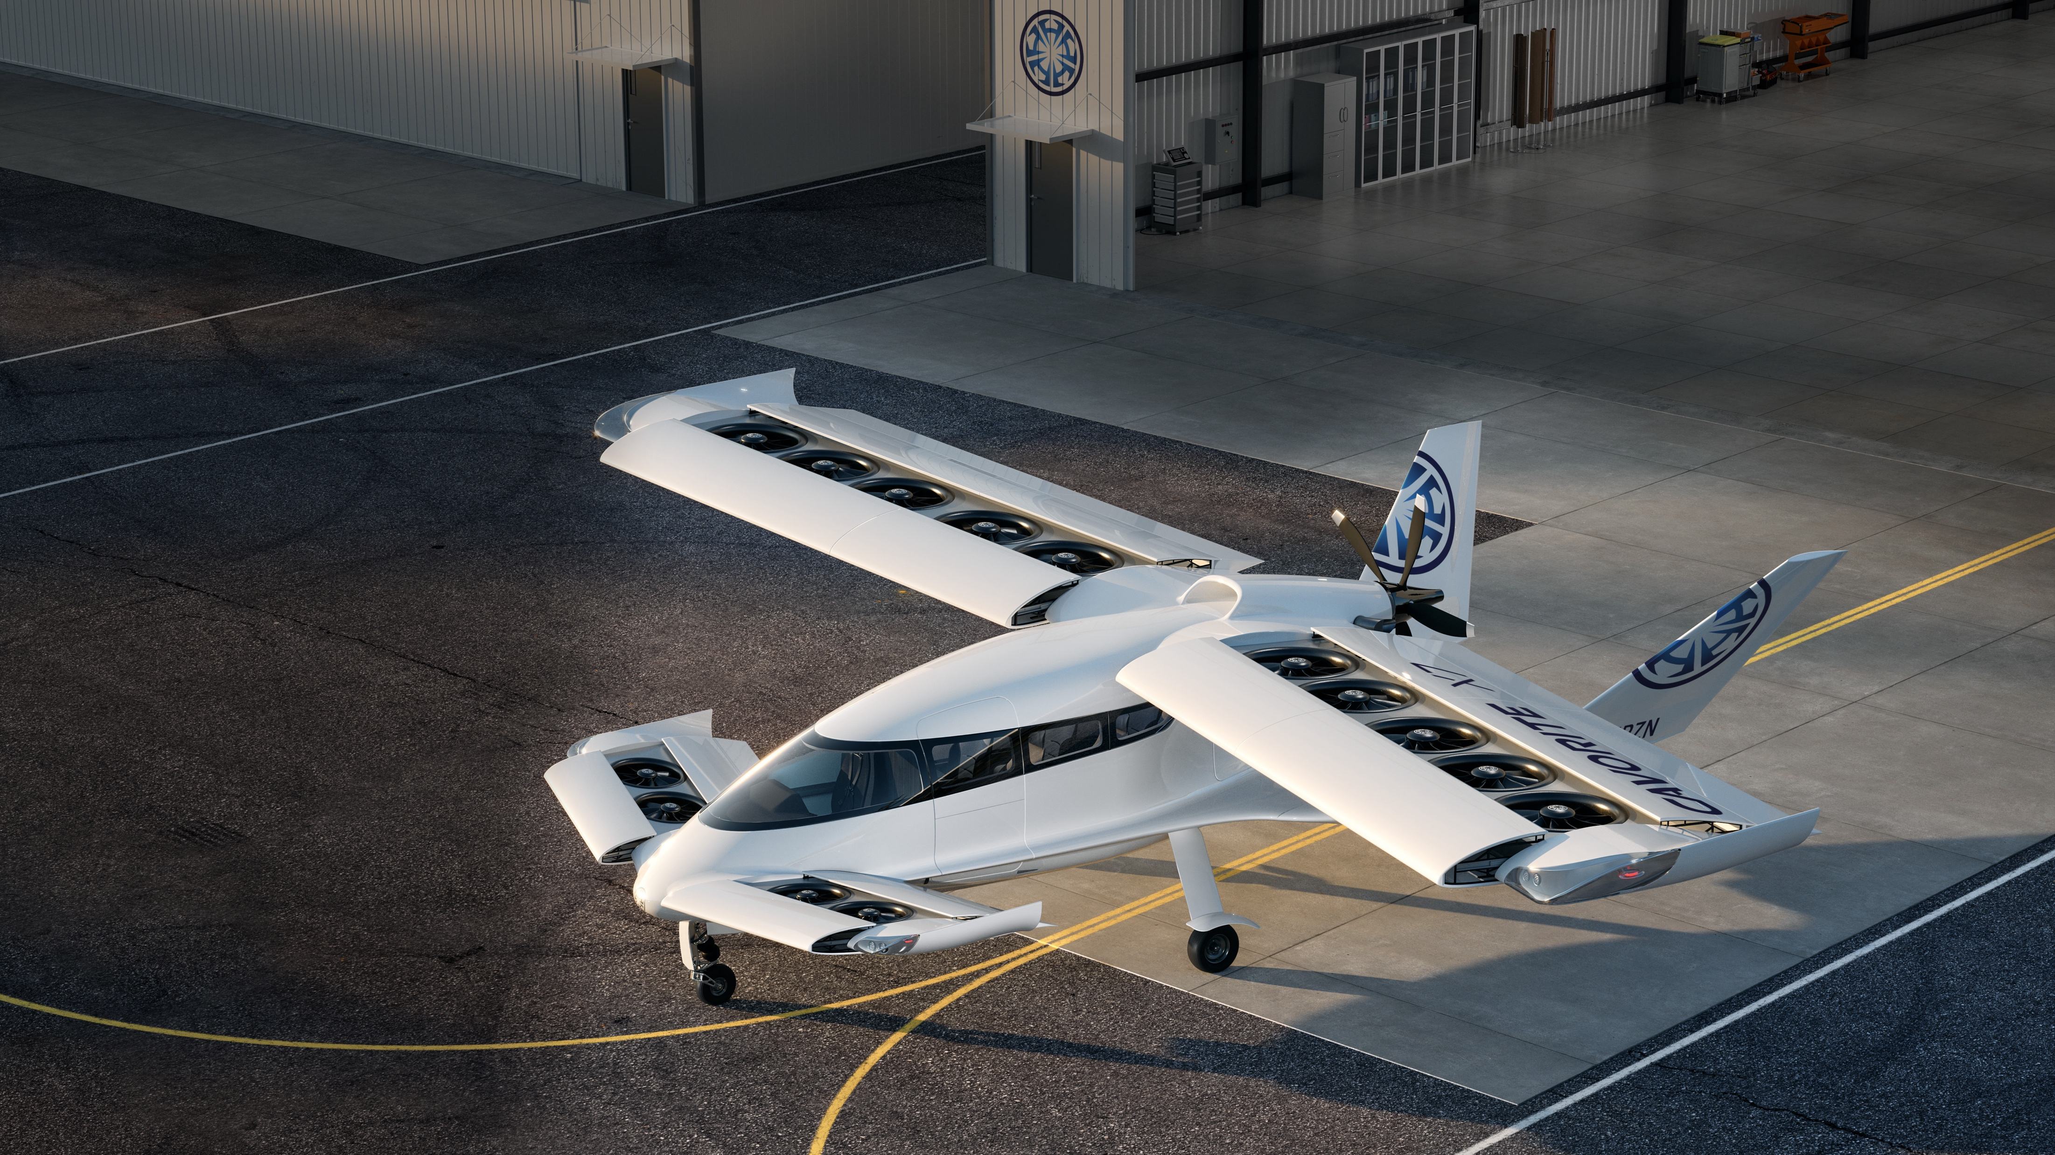
The Cavorite X7
Company
Exchange
Headquarters
Founded
CEO
Market
New Horizon Aircraft
Nasdaq: HOVR
Toronto
2013
Brandon Robinson
Advanced air mobility
Seven-passenger hybrid eVTOL
Lower cost, faster flight, better range and safer than helicopters and other eVTOL aircraft
Rendering of the Cavorite X7
Vertical / short take off and landing; conventional takeoff, landing and flight
©2025 NEW HORIZON AIRCRAFT LTD.
PRIVATE AND CONFIDENTIAL
6

Slide 7
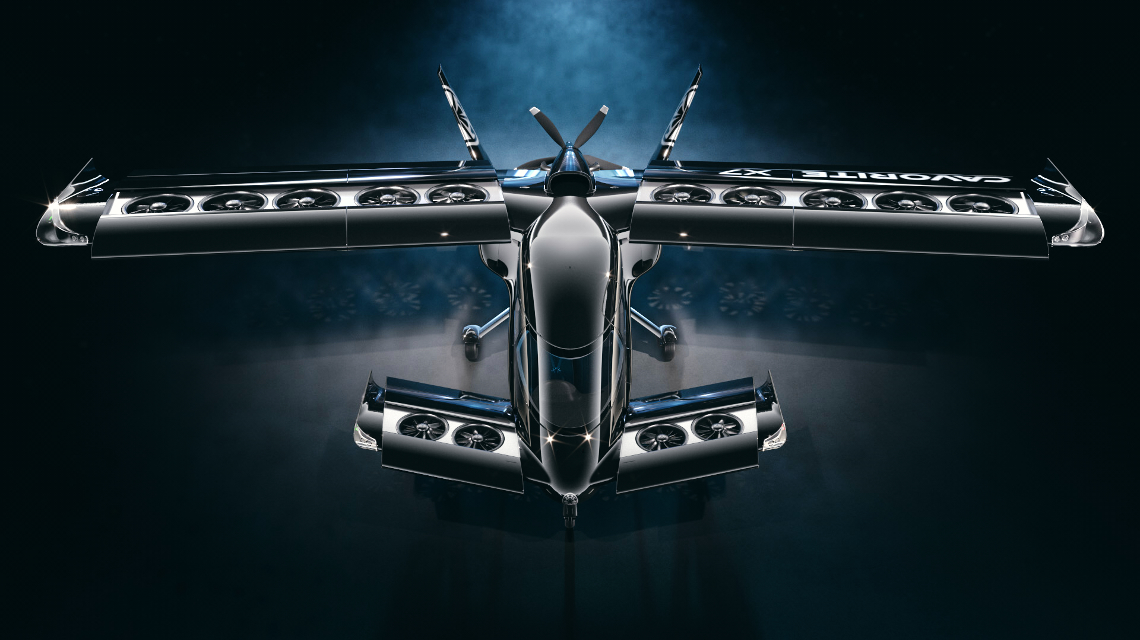
VERTICAL FLIGHT | NORMAL FLIGHT
Vertical lifting fans Unique in the industry; efficient enroute flight
Patented in-wing fan system (U.S. non-provisional utility patent 11,001,377)
PERFORMANCE
MAXIMUM EFFICIENCY
460 km/h
800 km
700 kg
7 people
Vertical and short takeoff
Hybrid-electric power
1
2
3
©2025 NEW HORIZON AIRCRAFT LTD.
¹ Maximum speed at 10,000 ft ² Range with 400 kg payload ³ Maximum useful load
PRIVATE AND CONFIDENTIAL
7

Slide 8
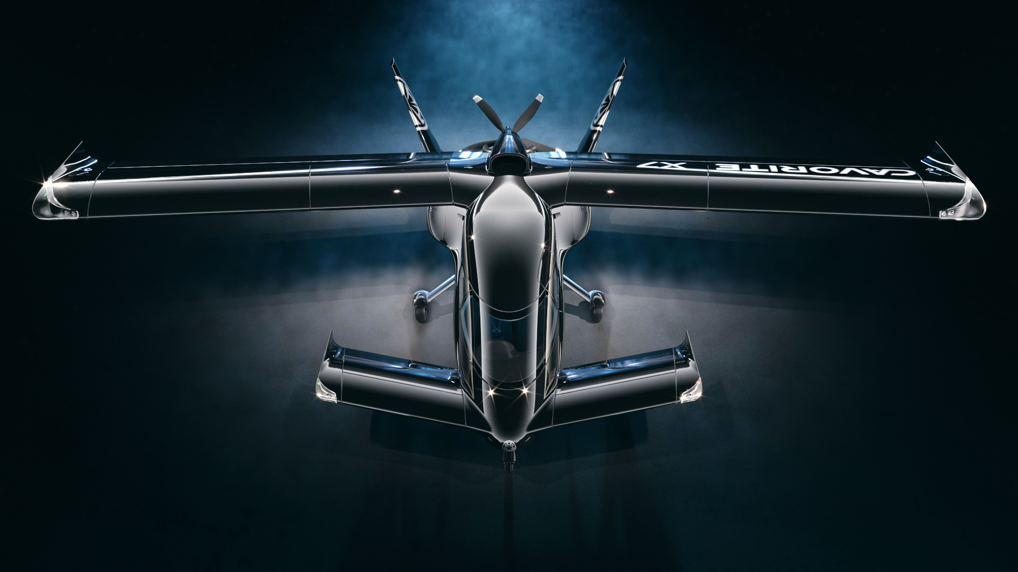
VERTICAL FLIGHT | NORMAL FLIGHT
Wings closed for enroute flight Flying like a normal aircraft for 98% of the mission
PERFORMANCE
MAXIMUM EFFICIENCY
460 km/h
800 km
700 kg
7 people
Conventional takeoff
Low drag, high speed
1
2
3
©2025 NEW HORIZON AIRCRAFT LTD.
¹ Maximum speed at 10,000 ft ² Range with 400 kg payload ³ Maximum useful load
PRIVATE AND CONFIDENTIAL
8

Slide 9
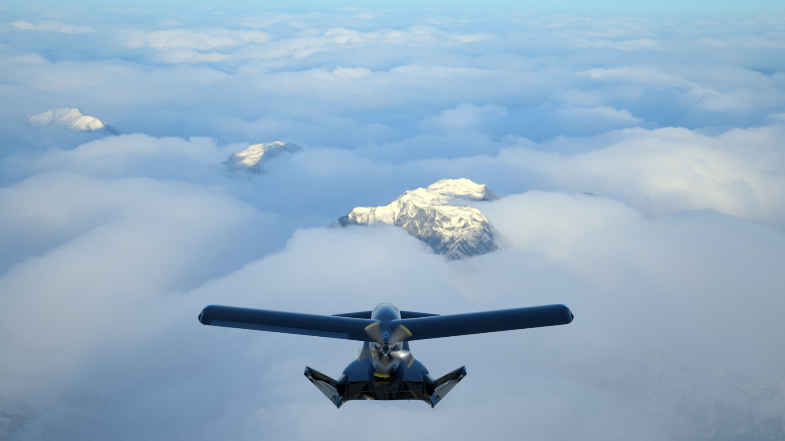
Horizon Aircraft is a company with significant potential in a rapidly growing new industry.
Projected total addressable market
Transport and logistics
$517 billion
Shared mobility
$457 billion
Military, defense
$10 billion
$1 trillion
Unique approach
Patented technology
Strong leadership
by 2040*
Rendering of the Cavorite in flight
*Morgan Stanley, Autonomous Aircraft, 2021
©2025 NEW HORIZON AIRCRAFT LTD.
PRIVATE AND CONFIDENTIAL
9

Slide 10
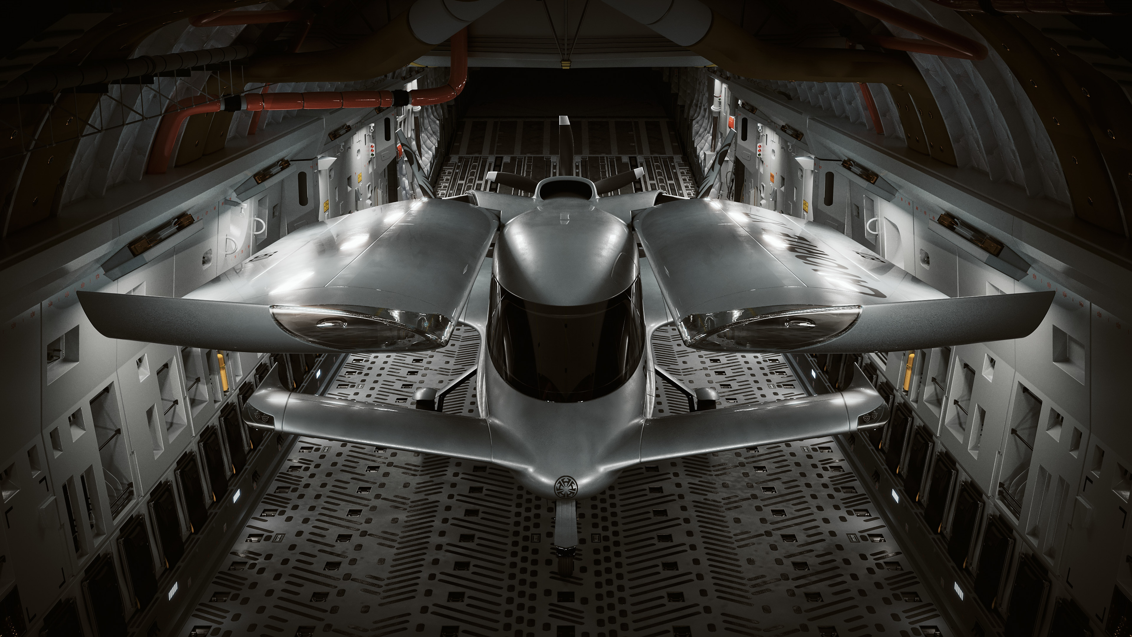
MISSIONS | MILITARY
Cavorite X7 in a C17 transport aircraft
Designed for rapid deployment
©2025 NEW HORIZON AIRCRAFT LTD.
PRIVATE AND CONFIDENTIAL
10

Slide 11
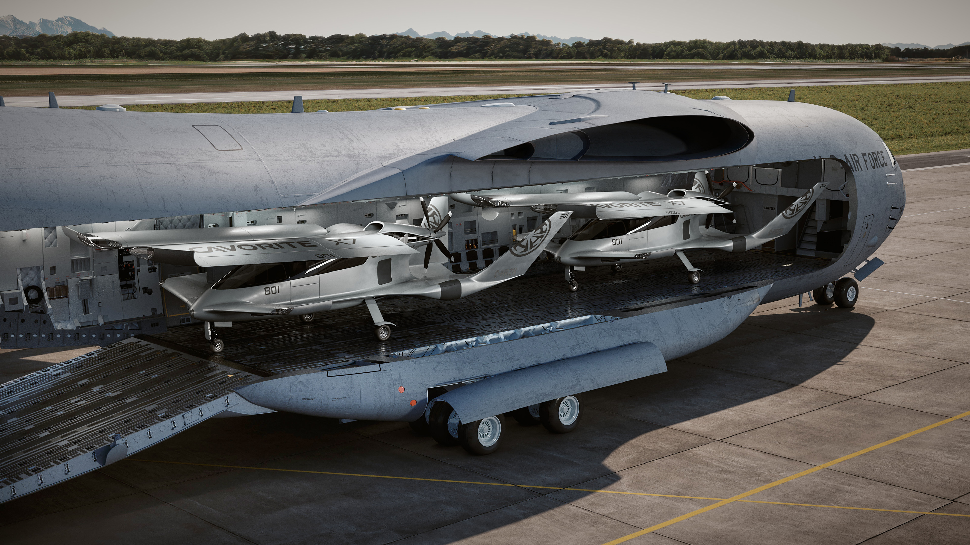
MISSIONS | MILITARY
Two Cavorite X7s in a C17 transport aircraft
©2025 NEW HORIZON AIRCRAFT LTD.
PRIVATE AND CONFIDENTIAL
11

Slide 12
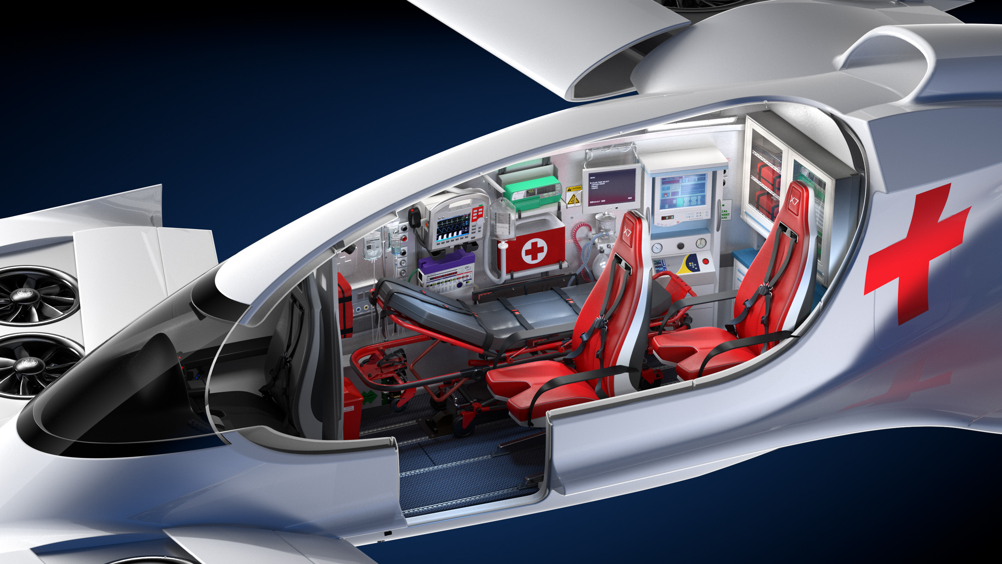
MISSIONS | EMERGENCY MEDICAL SERVICES
©2025 NEW HORIZON AIRCRAFT LTD.
Transport people or time-sensitive drugs at twice the speed of a helicopter at a fraction of the cost
PRIVATE AND CONFIDENTIAL
12

Slide 13
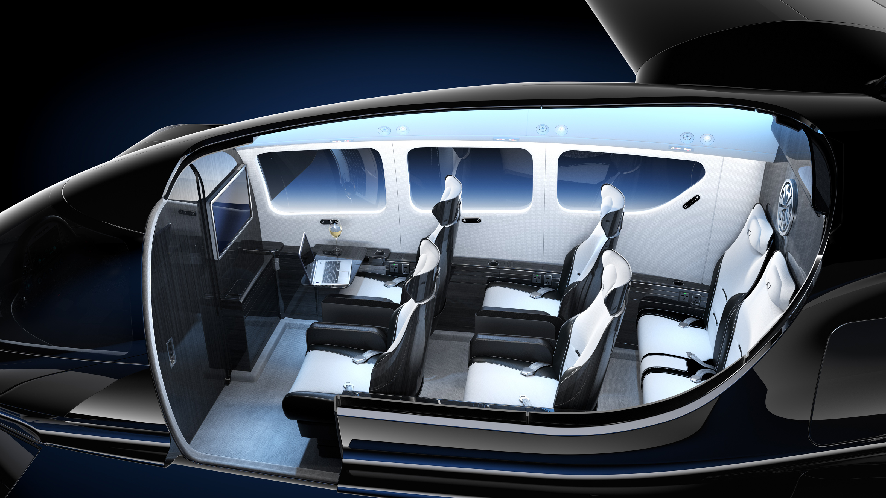
MISSIONS | LUXURY BUSINESS TRAVEL
Twice the speed of a helicopter in a safer, more comfortable aircraft
©2025 NEW HORIZON AIRCRAFT LTD.
PRIVATE AND CONFIDENTIAL
13

Slide 14
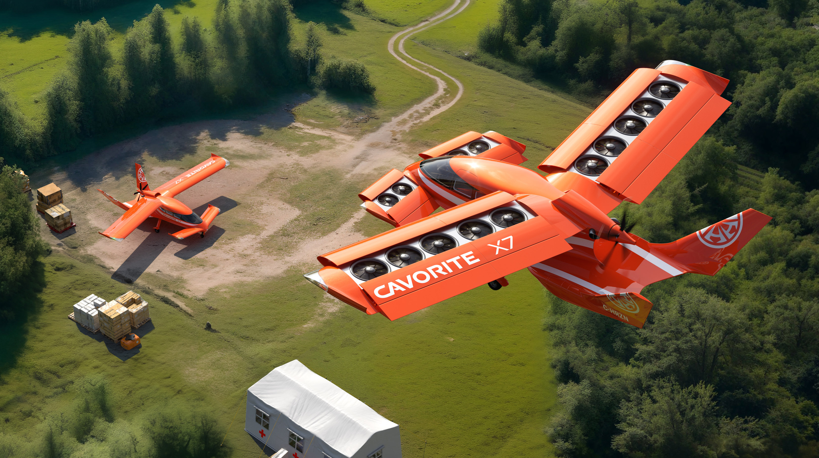
MISSIONS | DISASTER RELIEF
Deploy aircraft at twice the speed of a helicopter, with no infrastructure required, saving lives
©2025 NEW HORIZON AIRCRAFT LTD.
PRIVATE AND CONFIDENTIAL
14

Slide 15
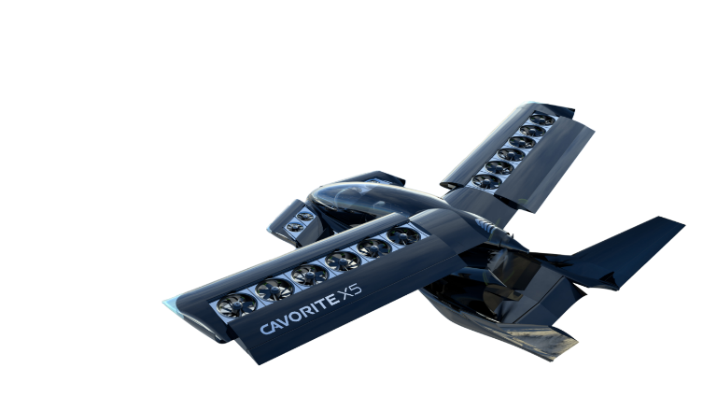
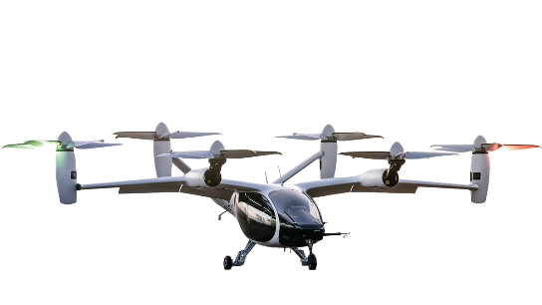
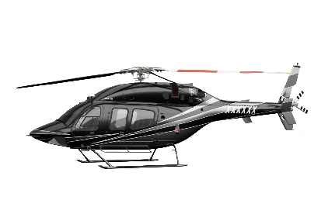
EXCEPTIONAL COST, PERFORMANCE, SAFETY, AND VERSATILITY
Cost per passenger seat mile – 500 hours use
Horizon Cavorite X7
Joby
Aviation S4
Bell Model 429
$4.75
$8.43
$7.98
¹
²
³
Maximum speed
Horizon Cavorite X7
460 km/h
Joby S4
320 km/h
Bell 429
250 km/h
Payload
⁴
Horizon Cavorite X7
550 kg
Joby S4
450 kg
Bell 429
600 kg
Performance metrics based on investor presentations and public data as of January 2024.
¹ Based on 66% load factor, 500 hours per year, 50% gross margin ² Based on engineering calculations ³ Blade, $195 flight from JFK to Manhattan ⁴ Medium fuel loads
©2025 NEW HORIZON AIRCRAFT LTD.
PRIVATE AND CONFIDENTIAL
15

Slide 16
AN ALL-WEATHER DESIGN
Intent to certify the aircraft for flight into known icing
Designed for bad weather operations
Multi-mission capability
Rendering of the Cavorite X7 in flight
©2025 NEW HORIZON AIRCRAFT LTD.
PRIVATE AND CONFIDENTIAL
16

Slide 17
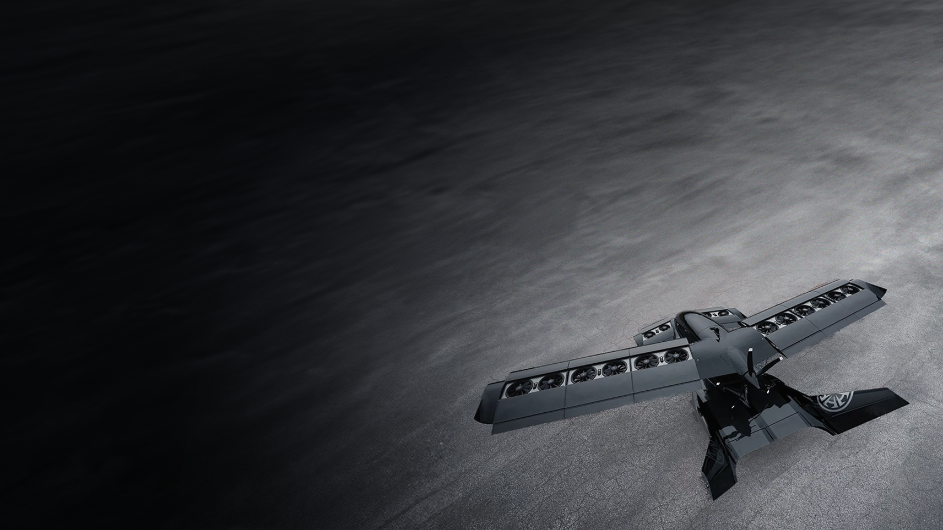
RAPID TECHNICAL DEVELOPMENT PROGRESS
JANUARY 2021
Horizon Aircraft reveals Cavorite X5 design
UPCOMING MILESTONES
2025
Certification progress with Transport Canada; Extensive iron bird testing
MARCH 2021
First flight of sub-scale prototype; concept review for X7 upgrade
2026
System testing, CDR, and build of the full-scale technical demonstrator
JANUARY 2022
Awarded U.S. Department of Defense Phase 1
High Speed Vertical Takeoff and Landing contract
2028
Certification nearing completion, flight testing of full-scale aircraft underway
2029
First low-rate aircraft delivered*
AUGUST 2022
Flight testing for large-scale prototype (22-foot wingspan, 15-feet long, 550 lbs) begins
DECEMBER 2022
First tethered outdoor flight test of 50%-scale prototype
MARCH 2023
Wind tunnel transition flight testing of large-scale prototype
AUGUST 2024
Flight testing of the large-scale prototype nearing completion
JANUARY 2025
Design of the full-scale aircraft matures with test rigs being built for propulsion and wing actuation systems
Large-scale Cavorite prototype
©2025 NEW HORIZON AIRCRAFT LTD.
*Based on current estimates
PRIVATE AND CONFIDENTIAL
17

Slide 18
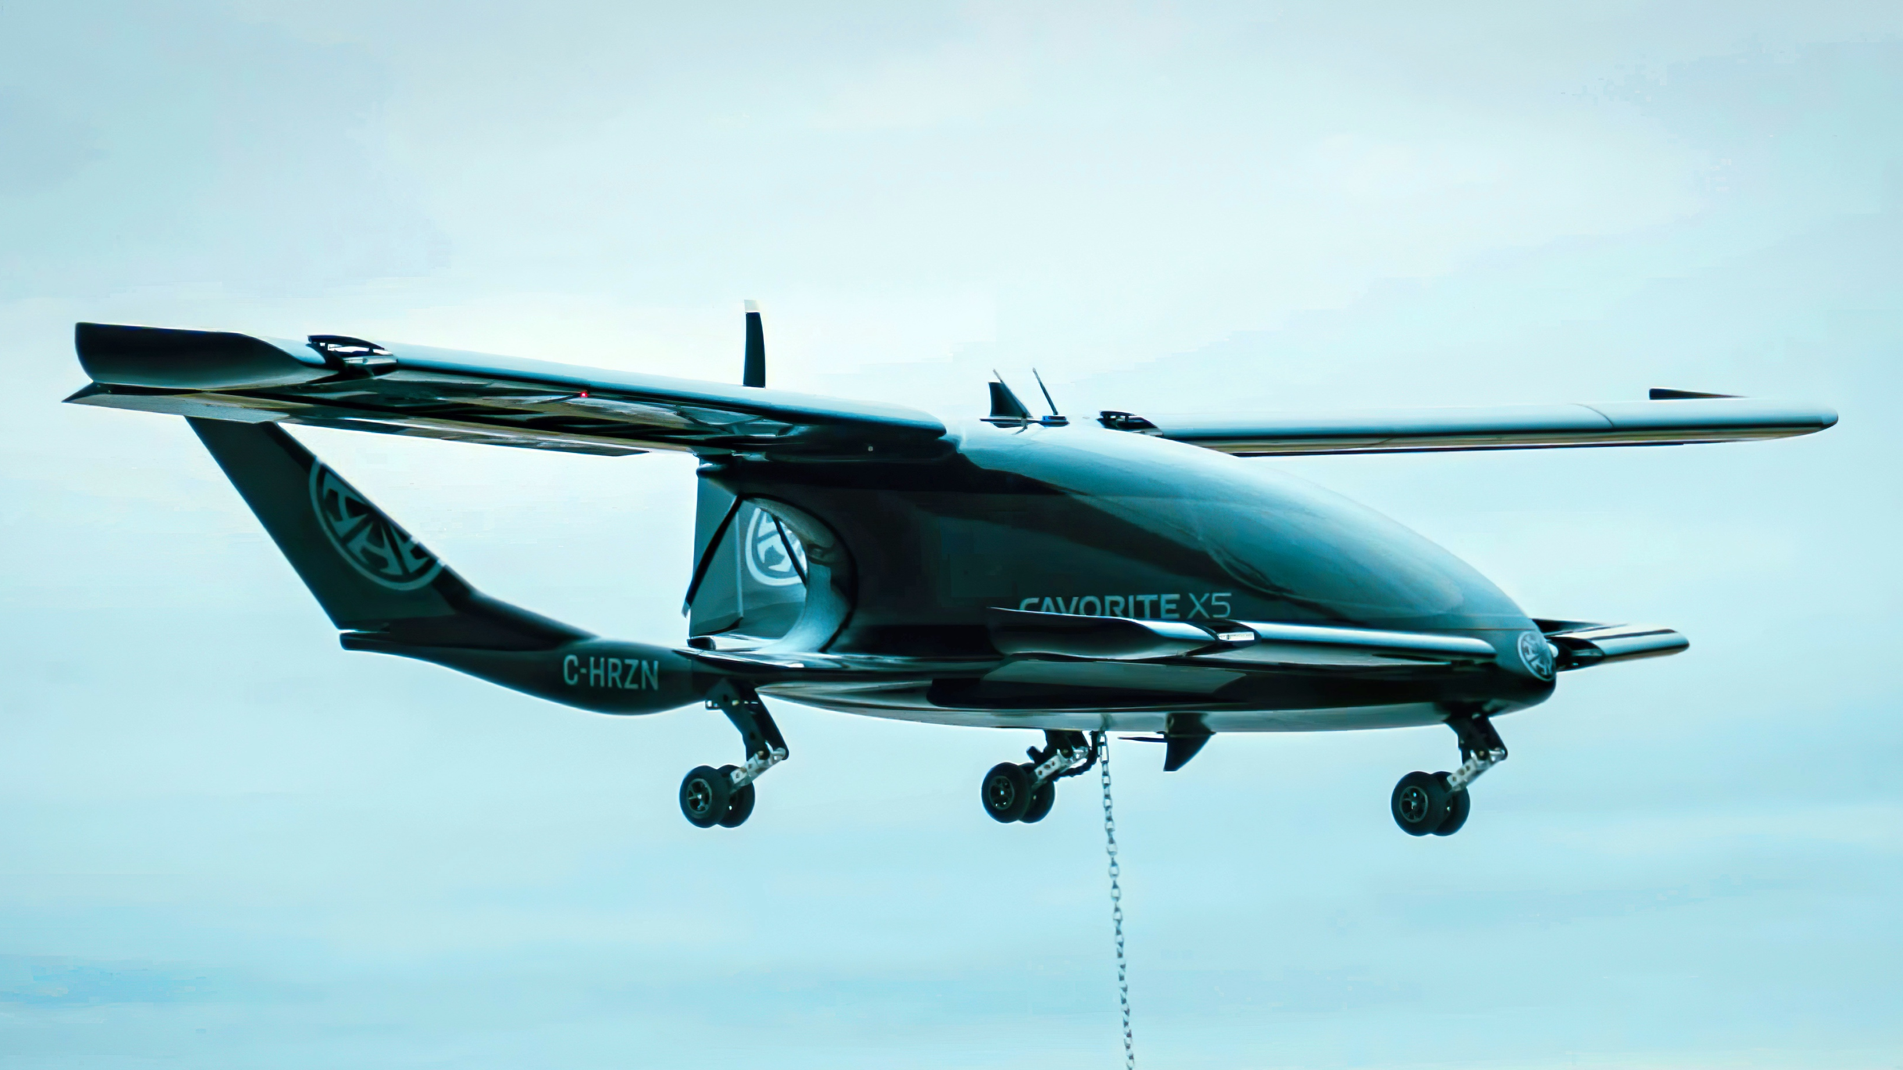
RAPID TECHNICAL DEVELOPMENT PROGRESS
Large-scale flight test nearing completion | full-scale aircraft build underway
©2025 NEW HORIZON AIRCRAFT LTD.
PRIVATE AND CONFIDENTIAL
18

Slide 19
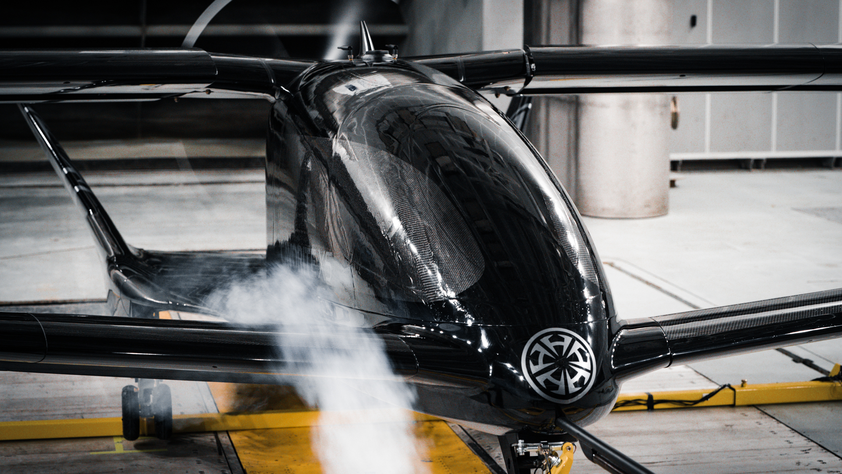
RAPID TECHNICAL DEVELOPMENT PROGRESS
Exceptional performance of the large-scale prototype has allowed the team accelerate development of a full-scale aircraft.
Large scale model of the Cavorite during wind tunnel testing
WATCH OUR WIND TUNNEL TEST
©2025 NEW HORIZON AIRCRAFT LTD.
PRIVATE AND CONFIDENTIAL
19

Slide 20
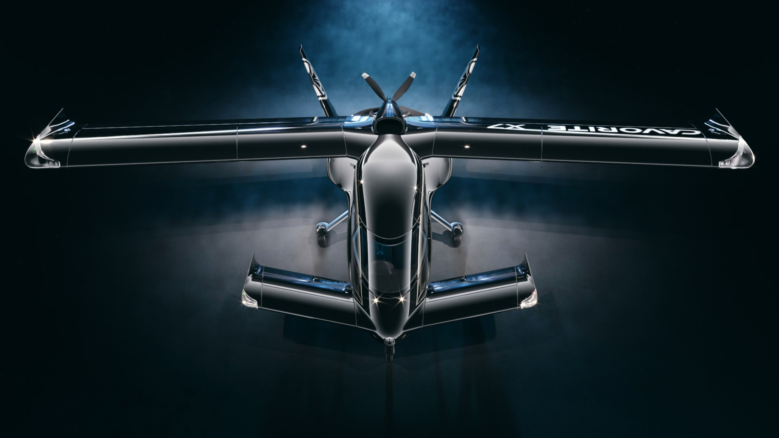
MULTIPLE PARTNERSHIP OPPORTUNITIES
PARTNER TYPE
RELATIONSHIP
Regional operators
Trading companies, equipment resellers
Buy and resell Cavorite aircraft to operators
Larger operators
Airlines, private air transportation providers
Buy and operate Cavorite vehicles to provide flight service
Vehicle finance
Banks, leasing companies
Finance the Cavorite for operators
Parts manufacturers
Parts, engine, and battery manufacturers
Provide parts to Horizon Aircraft’s manufacturing
©2025 NEW HORIZON AIRCRAFT LTD.
PRIVATE AND CONFIDENTIAL
20

Slide 21
AIRCRAFT CERTIFICATION – TRANSPORT CANADA
Preliminary design
Detailed design
Construction
Testing
Certification
2026
2027
2028
We Are Here
Critical Design Review
Full-scale prototype complete
Type certification finishing
ADVANTAGES
Cert rules are now established
A normal aircraft for 98% of mission
Lower cost than FAA type cert
TCCA cert = FAA cert quickly
©2025 NEW HORIZON AIRCRAFT LTD.
PRIVATE AND CONFIDENTIAL
21

Slide 22
SUMMARY
Competitive advantage
Lower cost, faster, safer and longer range than competition
Proprietary technology
Rendering of the Cavorite X7 in flight
Patented technology protecting the unique concept
Clear path
Reasonable and achievable road to certification and commercial sales
Leadership
Experienced and driven leadership team
©2025 NEW HORIZON AIRCRAFT LTD.
PRIVATE AND CONFIDENTIAL
22

Slide 23
JOIN US TO HELP BUILD A BETTER FUTURE
Rendering of the Cavorite on approach to land
CONTACT
BRANDON ROBINSON
Chief Executive
brandon@horizonaircraft.com
1.613.866.1935
NASDAQ: HOVR
©2024 NEW HORIZON AIRCRAFT LTD.
PRIVATE AND CONFIDENTIAL
23

