Slide 1
Empowering the Future Through Clean Technology
Presented by Bill Smith, CEO

Slide 2
NOTICE REGARDING FORWARD-LOOKING STATEMENTS
This communication contains “forward-looking statements” within the meaning of the safe harbor provisions of the U.S. Private Securities Litigation Reform Act of 1995. Forward-looking statements can be identified by words and phrases such as: : “anticipated,” “continue,” “estimate,” “expected,” “projected,” “plan,” “ultimately,” “will” and similar words and phrases that are intended to identify future events. Forward-looking statements are neither historical facts nor assurances of future performance. Instead, they are based only on our current beliefs, expectations, and assumptions regarding the future of our business, future plans, events and strategies, projections, anticipated events and trends, the economy and other future conditions.
We intend such forward-looking statements to be covered by the safe-harbor provisions for forward-looking statements contained in the Private Securities Litigation Reform Act of 1995 and are including this statement for purposes of complying with those safe-harbor provisions. Forward-looking statements are based on current expectations and assumptions that are subject to risks and uncertainties which may cause actual results to differ materially from the forward-looking statements. Our ability to predict results or the actual effect of future plans or strategies is inherently uncertain. Factors which could have a material adverse affect on our operations and future prospects on a consolidated basis include but are not limited to changes in economic conditions, legislative/regulatory changes, availability of capital, interest rates, competition, and generally accepted accounting principles.
These risks and uncertainties should also be considered in evaluating forward-looking statements and undue reliance should not be placed on such statements. We undertake no obligation to update or revise publicly any forward-looking statements, whether as a result of new information, future events or otherwise.
Notes:
Pennsylvania wastewater could supply 40% of US lithium demand
Lithium Market Size, Share & Growth | Industry Report, 2030

Slide 3
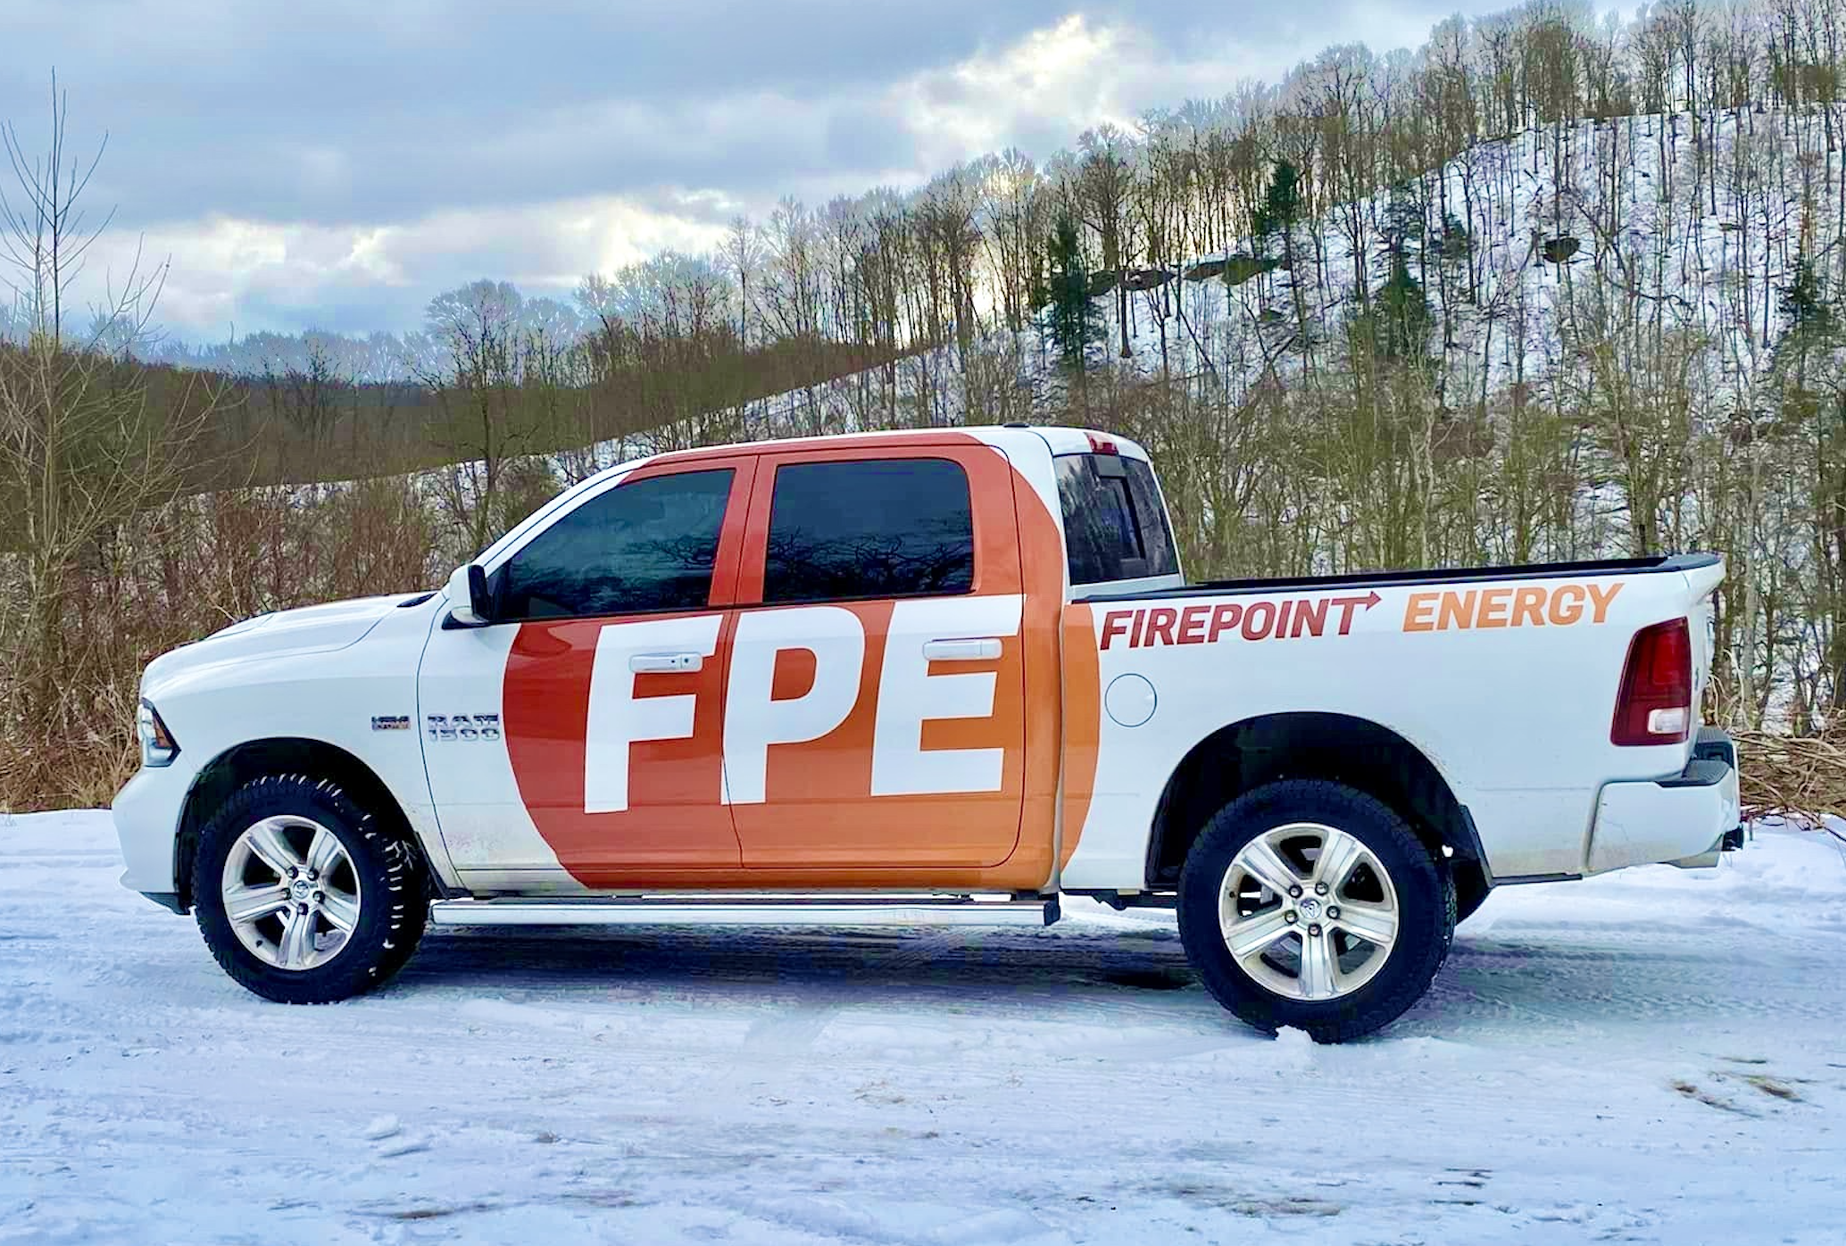
Our Company and Mission
Firepoint Energy was created in 2024
Pilot site in Saltsburg (Tunnelton), Pennsylvania
We transform waste coal into synthetic aviation fuel (SAF)
We extract Rare Earth Elements (REEs) from the waste coal.
Notes:
Pennsylvania wastewater could supply 40% of US lithium demand
Lithium Market Size, Share & Growth | Industry Report, 2030

Slide 4
Why are these products valuable?
Airlines are demanding 90 billion gallons of SAF annually
A record of 50 million gallons of SAF were produced in 2024
REEs and critical minerals have been declared essential to several vital U.S. businesses, and also to national defense
The U.S. has become dependent on China for REEs and critical minerals
Notes:
Pennsylvania wastewater could supply 40% of US lithium demand
Lithium Market Size, Share & Growth | Industry Report, 2030

Slide 5
The Hidden Value of Waste Coal
There are more than 9,000 waste coal piles in Pennsylvania alone that contain coal refuse with untapped BTU value.
All the waste coal piles we had tested contain valuable minerals on the U.S. government’s critical mineral list.

Slide 6
Our Processes
First, we use plasma gasification to transform waste coal into synthetic gas (syngas).
Then we use a gas-to-liquids system (GTL) to transform the syngas into SAF
Along the way, we extract REEs and other valuable minerals from the remaining residue.

Slide 7
Our Activities Permanently Clean the Environment
The waste coal piles left behind by coal industry activity produce acid mine drainage (AMD).
AMD is a leading polluter of groundwater and water systems throughout Pennsylvania and other coal-producing regions.
AMD has been steadily pouring into the coal region’s adjacent waterways for decades.
Each plasma gasifier eliminates 50 tons of waste coal each day by converting it into synthetic gas, thereby eliminating AMD.
We can also directly convert the AMD into jet fuel by increasing its hydrogen content.

Slide 8
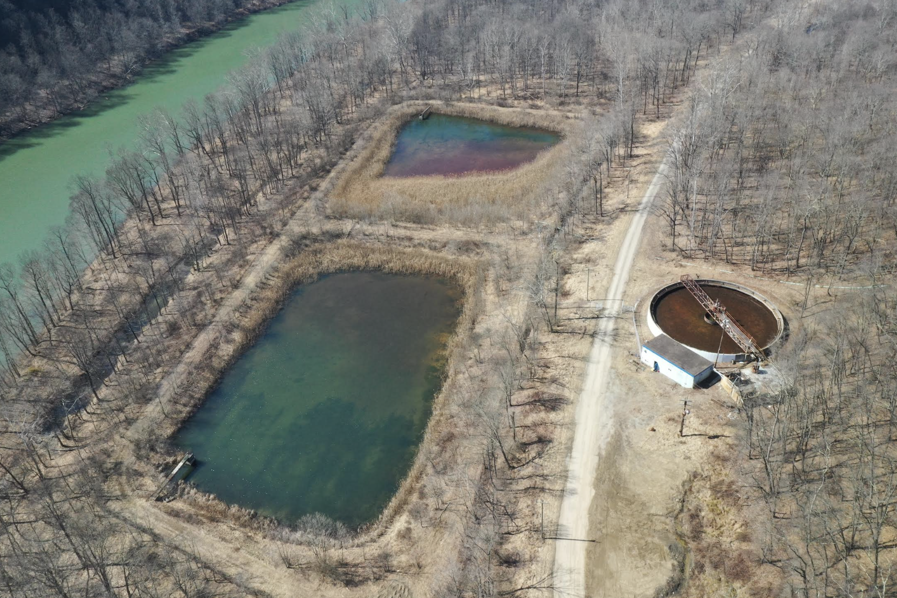
Our Pilot Site: Saltsburg, Pennsylvania
We have control of the 100-acre site, and development is already underway
The site has a wastewater treatment plant that we are restoring for lithium extraction
Four million tons of waste coal on-site
Contains $1.2 billion worth of REEs
Can be converted into an additional $1.2 billion worth of SAF

Slide 9
Our Plan
Complete the lithium extraction plant to extract lithium from natural brine water; rapid path to productivity (September 2025)
Build the waste-to-energy plan and begin converting the on-site waste coal into SAF (July 2026)
Deploy enough gasifiers at the location to eliminate the waste coal over the course of 20 years, keeping capex low, and guaranteeing sustainable jobs
Acquire the rights to further sites with larger quantities of waste coal and upscale our proven processes (2027)

Slide 10
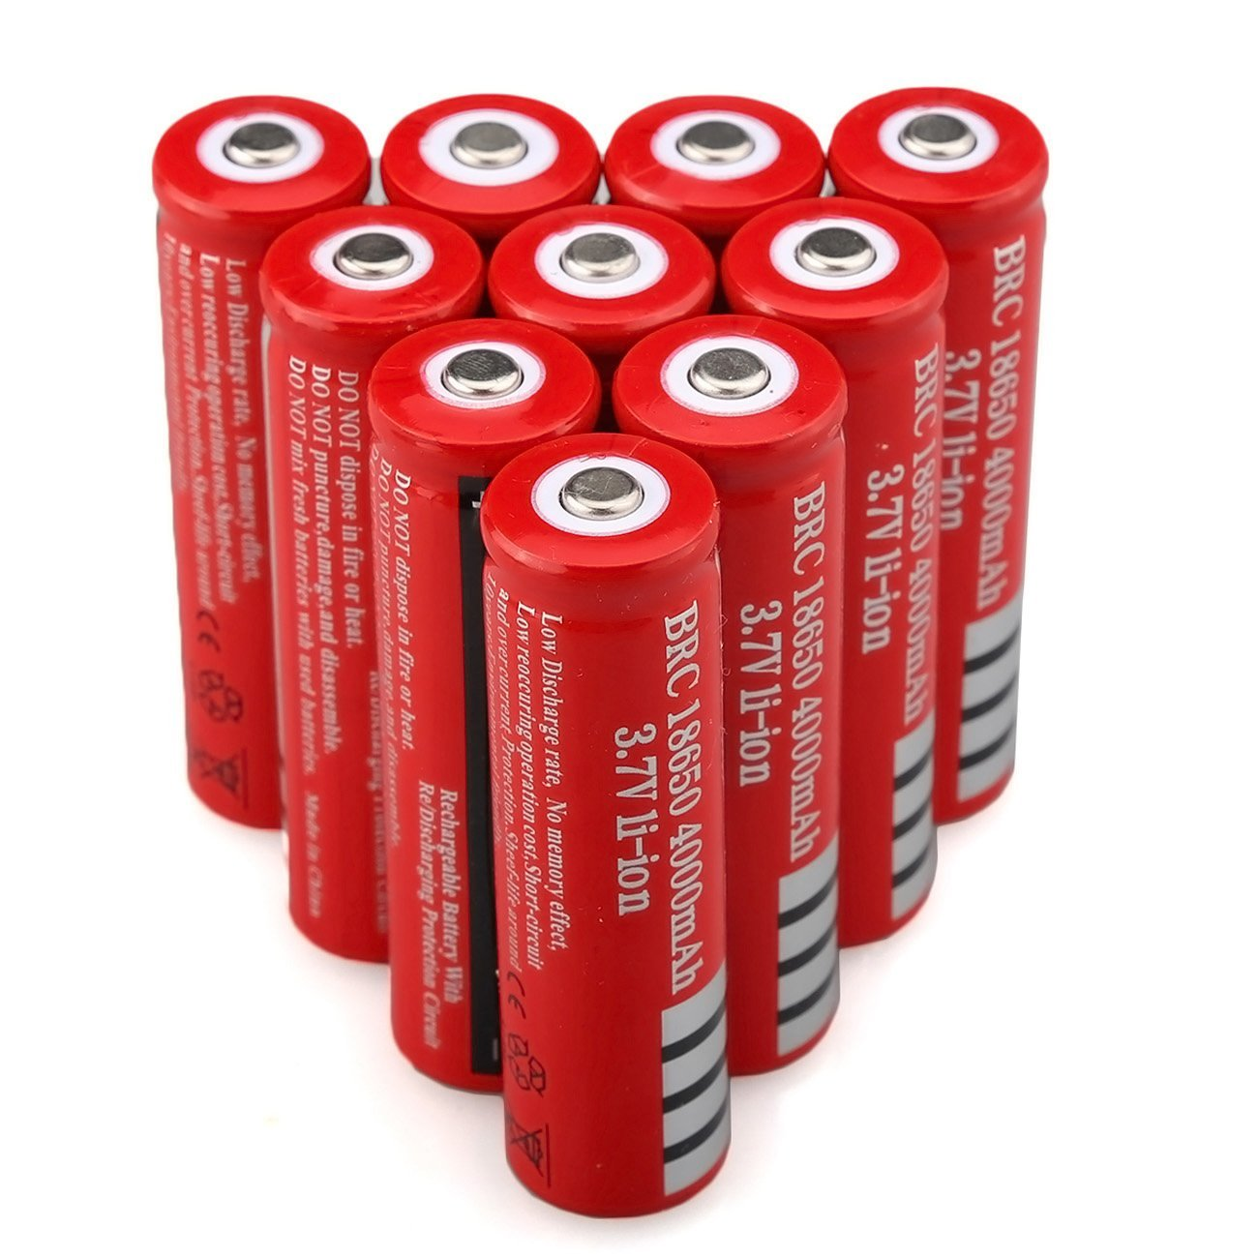
Future Consideration
Any additional power we generate will be attractive to energy-intensive computer operations (i.e., Bitcoin miners, AI data centers); global energy demands are continuing to increase.
Our process is replicable at nearly any waste coal site in the world with sufficient waste coal and adequate mineral resources.

Slide 11
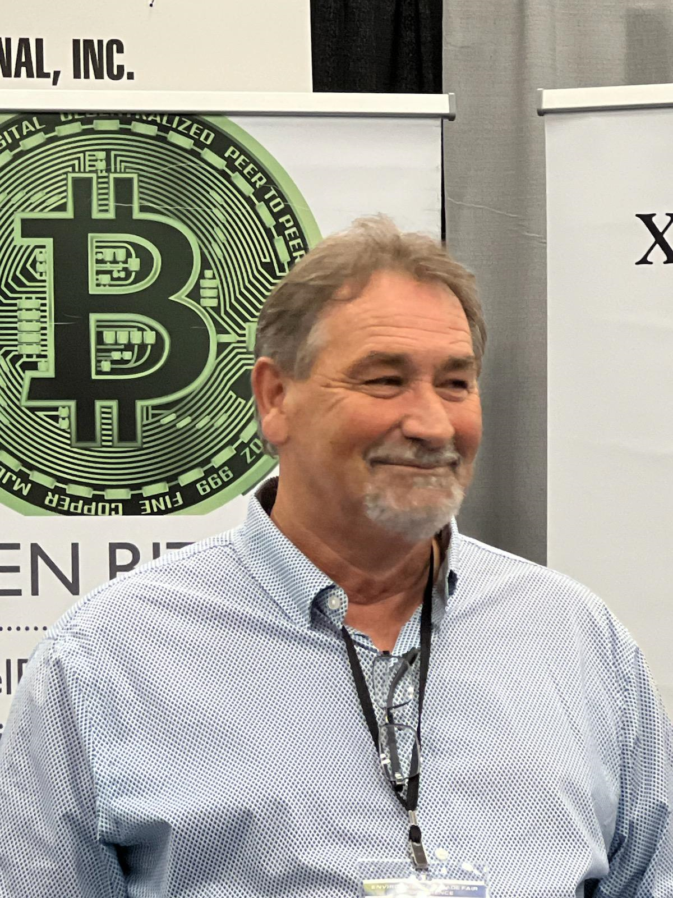
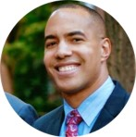
Management Team
Bill Smith
CEO, Chairman
Bill Smith brings decades of business leadership experience, including taking multiple companies public. With over 20 years in the alternative energy sector, Bill has deep knowledge of technologies such as hydrogen, gas-to-liquids, and ethanol. His background includes frequent interactions with government agencies at the state and federal levels, including the Environmental Protection Agency.
Shelly Befumo
President/COO
Shelly Befumo is a corporate finance executive with over 20 years of experience leading organizations through capital finance transactions, complex restructurings, and IPO readiness. Shelly has driven successful public and private funding rounds, specializing in regulatory compliance, investor relations, financial planning, and SEC reporting. She holds a Bachelor’s degree in Accounting and an MBA from William & Mary.
Ian Douglass
Senior VP/CCO
Ian Douglass has extensive expertise in communications and marketing, spanning public and private sectors. His career includes roles as an NBC News reporter, leadership in the Michigan House of Representatives, and over a decade as a business communications consultant, including for waste-to-energy ventures. Ian holds degrees from the University of Michigan, Northwestern University, and the Quantic School of Business & Technology.

Slide 12
Board of Directors
Bill Smith
CEO, Chairman
Bill Smith brings decades of business leadership experience, including taking multiple companies public. With over 20 years in the alternative energy sector, Bill has deep knowledge of technologies such as hydrogen, gas-to-liquids, and ethanol. His background includes frequent interactions with government agencies at the state and federal levels, including the Environmental Protection Agency.
Robert (Bob) Beatty, Jr.
Board of Directors
Robert (Bob) Beatty has spent more than two decades in the natural gas business. Over the course of his career, Robert has been acquiring and folding smaller natural gas companies into his portfolio. He serves in a leadership position with the Pittsburgh Region Clean Cities and is also a board member for the Pennsylvania Independent Oil and Gas Association (PIOGA). Robert strives to develop technologies that will advance the use for natural gas on several fronts.
Dale Rasmussen Board of Directors
Dale Rasmussen has 30 years of experience in clean tech, alternative energy, and banking. He was a founding member of the Board of Directors of Fisker Automotive and served as the Chairman of the Board since its formation. Mr. Rasmussen has served as a member of the Board of Directors for more than a dozen private and public companies, raising more than $1 billion in his tenure. Three of the companies he co-founded reached market capitalizations of over half a billion dollars.

Slide 13
THANK YOU
FIREPOINT ENERGY INC
(307) 225-9832
investorrelations@firepoint.energy
www.firepoint.energy

